Slide 1
This is my father’s world
Do your own research,
Come to your own conclusions
Suggested books:
The Genesis Record, Henry Morris
Tornado in a Junkyard, James Perloff
Suggested websites:
www.bible.ca www.creationism.org
www.iooe.org
www.icr.org
www.answersingenesis.org
Notes:
Psalm 104:6, terraforming

Slide 2
This is my father’s world
The story of
The flood
How the world came to look like it does
Notes:
Psalm 104:6, terraforming

Slide 3
The pre-flood world
An “expanse” (firmament, canopy) encircled the earth in water (Genesis 1:6-7)
Rain did not occur (Genesis 2:6)
Different landscape (Genesis 2:10-14)
All creation was “very good” (Genesis 1:25) – no flaws, weaknesses, etc.
Notes:
It began with God
It was formed by God
It was revealed through God
It was subjected to God

Slide 4
The pre-flood world
Theoretical consequences include …
  “Greenhouse” effect through reduced radiation, high humidity, stable and high temperatures
  Large-sized plants and animals
  Greatly increased lifespans
  Minimal wind and water currents

Slide 5
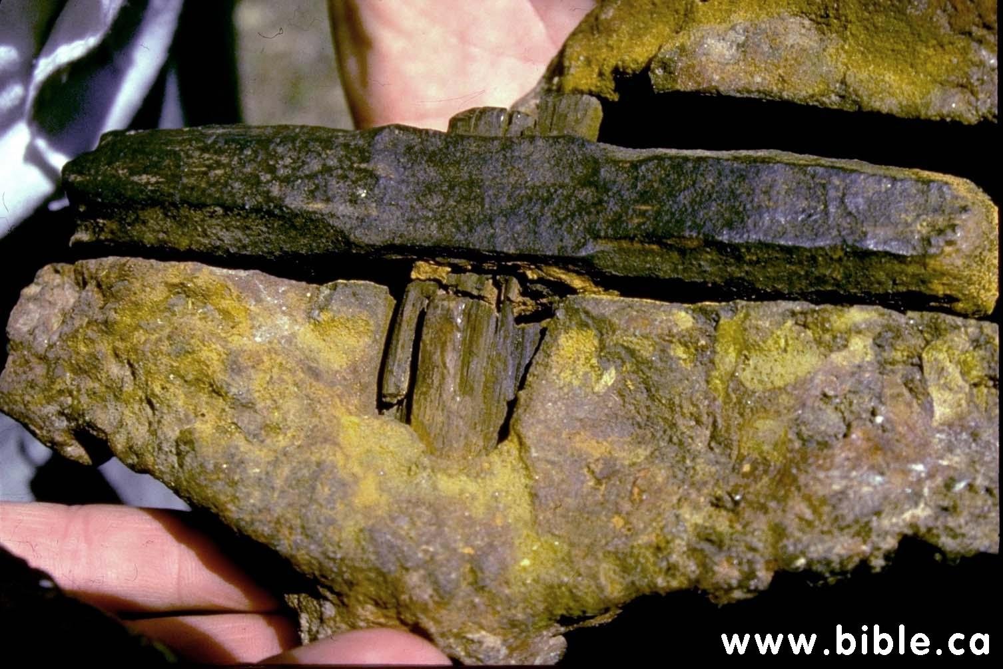
The pre-flood world
Hammer found in Lower Cretaceous sandstone
  Metallurgy different from modern iron
  Anti-rust coating does not form in current atmosphere
  Evidence of ancient metalworking (Genesis 4:22)

Slide 6
The global flood
A local flood cannot explain …
  40 days of rain and prevailing (rising) waters for 150 days (Genesis 7:11, 24)
  The mountains covered (Genesis 7:20)
  Loss of all life (Genesis 7:23)
  An ark and animals (Genesis 6:14, 7:2)
  Global destruction (2 Peter 3:6)
Notes:
Evidences of global flood from archaeology

Slide 7
The global flood
The vapor canopy collapsed as massive subterranean water pockets were released
  “… on the same day all the fountains of the great deep burst open, and the floodgates of the sky were opened.” (Genesis 7:11)
Notes:
Evidences of global flood from archaeology

Slide 8
The global flood
Volcanic upheaval created massive new mountain ranges and oceans
  “... The waters were standing above the mountains. At Your rebuke they fled…. The mountains rose; the valleys sank down to the place which You established for them. You set a boundary that they may not pass over, so that they will not return to cover the earth.” (Psalm 104:6-9)
Notes:
Evidences of global flood from archaeology

Slide 9
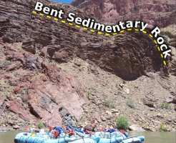
The global flood
Notes:
http://iooe.org/Was-There-A-Worldwide-Flood

Slide 10
The global flood
Animals fled to safety as they had time and opportunity
Currents quickly and drastically remade the surface of the earth with erosion and layers of sediment
Life forms were encased in sediment and immediately fossilized
Notes:
Evidences of global flood from archaeology

Slide 11
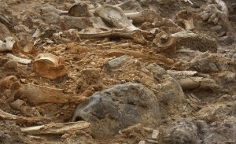
Evidence of the flood
Animals fled to safety as they had time and opportunity
Animal boneyards are on every continent, containing billions of fossilized animals from every ecosystem and “epoch”
Notes:
Evidences of global flood from archaeology

Slide 12
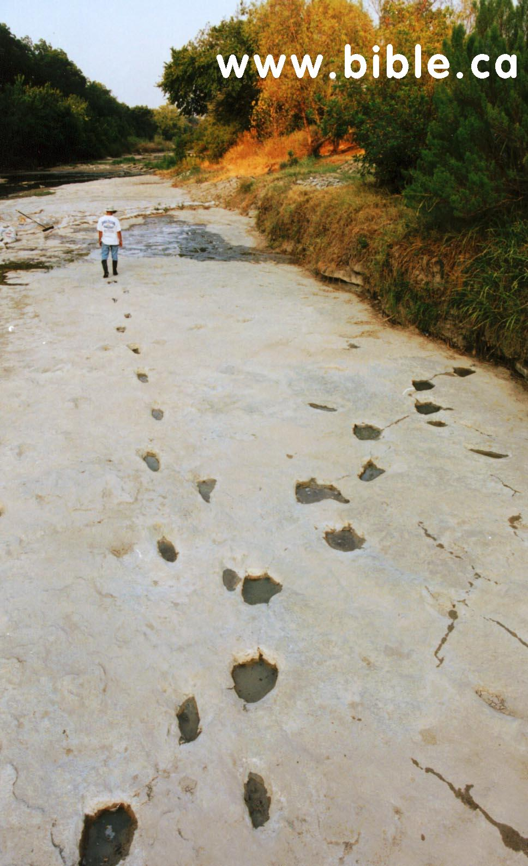
Evidence of the flood
Animals fled to safety as they had time and opportunity
Dinosaur and human tracks in the same strata in Glen Rose, Texas – sometimes even overlapping one another!
Notes:
http://www.bible.ca/tracks/taylor-trail.htm

Slide 13
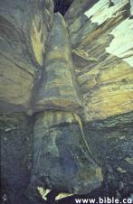
Evidence of the flood
Currents quickly and drastically remade the surface of the earth with erosion and layers of sediment
A fossilized tree passing through “millions of years” of sedimentation!
Notes:
Evidences of global flood from archaeology

Slide 14
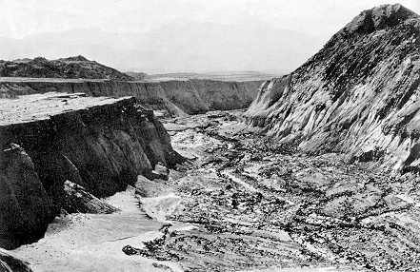
Evidence of the flood
Currents quickly and drastically remade the surface of the earth with erosion and layers of sediment
Mt. St. Helens deposited 400 feet of sediment – 100 layers totaling 25 feet in thickness in 1 day
Canyons up to 140 feet deep formed in 9 hours
Notes:
Evidences of global flood from archaeology

Slide 15
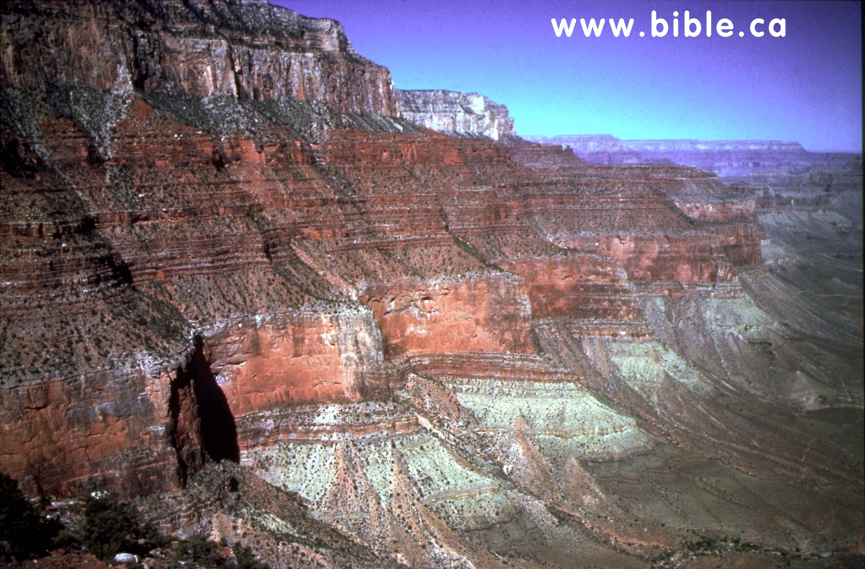
Evidence of the flood
Currents quickly and drastically remade the surface of the earth with erosion and layers of sediment
“Mississippian” and “Cambrian” strata stacked, and even “interbedded”!
Notes:
http://www.bible.ca/tracks/grand-canyon-interbedding.htm

Slide 16
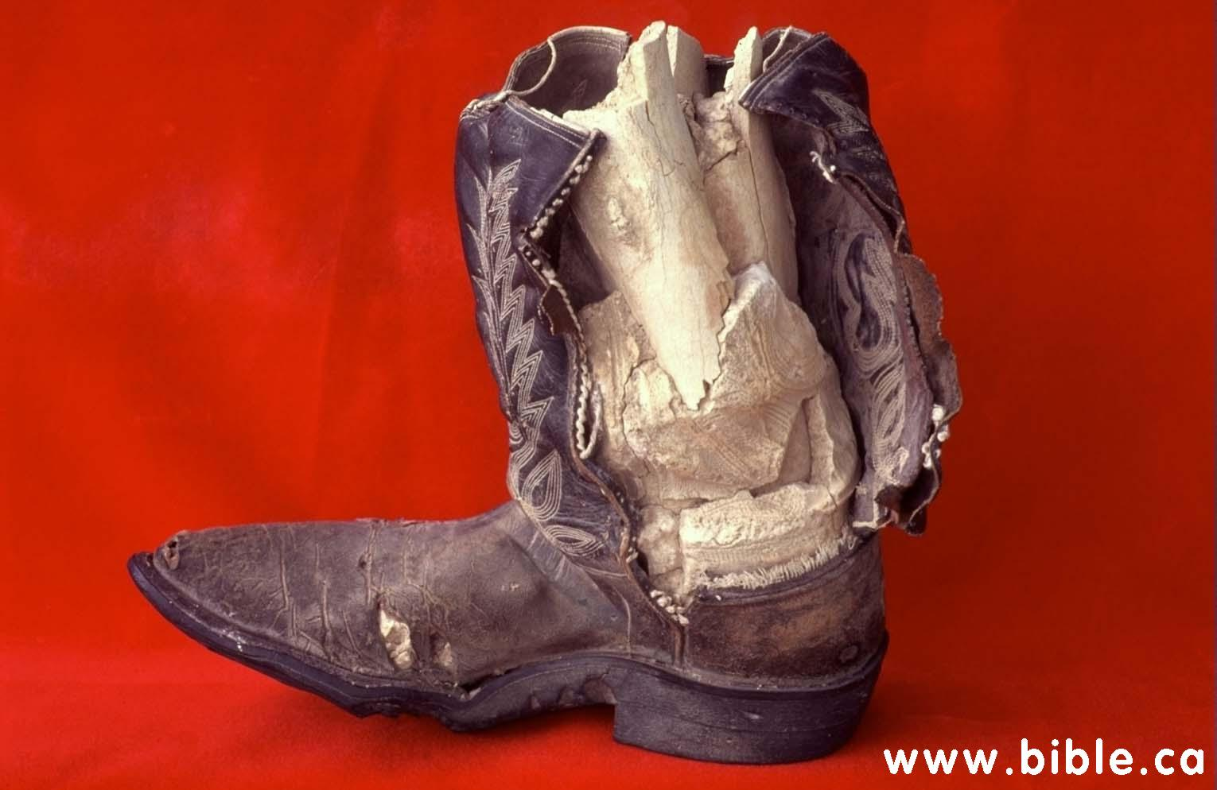
Evidence of the flood
Life forms were encased in sediment and immediately fossilized
A boot made in the 1950s encloses a fully fossilized human leg, clearly formed rapidly and recently
Notes:
Evidences of global flood from archaeology

Slide 17

Evidence of the flood
Life forms were encased in sediment and immediately fossilized
A fern was fossilized while in a bent position – forming the fossil before it had time to wilt, or even uncurl!
Notes:
Evidences of global flood from archaeology

Slide 18
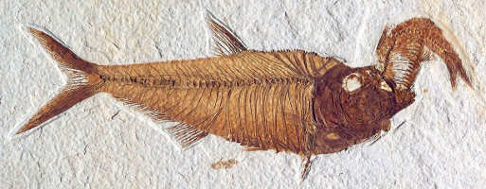
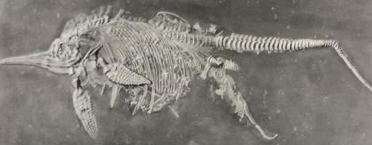

Evidence of the flood
Life forms were encased in sediment and immediately fossilized
A fish is fossilized while eating another fish
An ichthyosaur fossilized while giving birth
A jellyfish does not have time to decay
Notes:
Evidences of global flood from archaeology

Slide 19
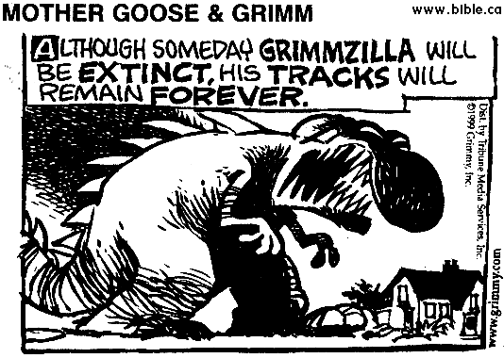
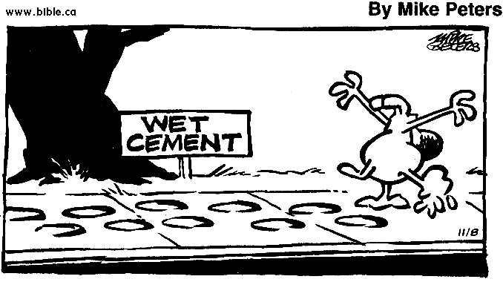
Evidence of the flood
Life forms were encased in sediment and immediately fossilized
Notes:
Evidences of global flood from archaeology

Slide 20
Notes:
Summary: Evolutionists say fossils are formed slowly; ample evidence fossils can, have and do form rapidly
Evolutionists say layers of strata form gradually over millions of years; ample evidence strata formed quickly, easily explained by the flood

Slide 21

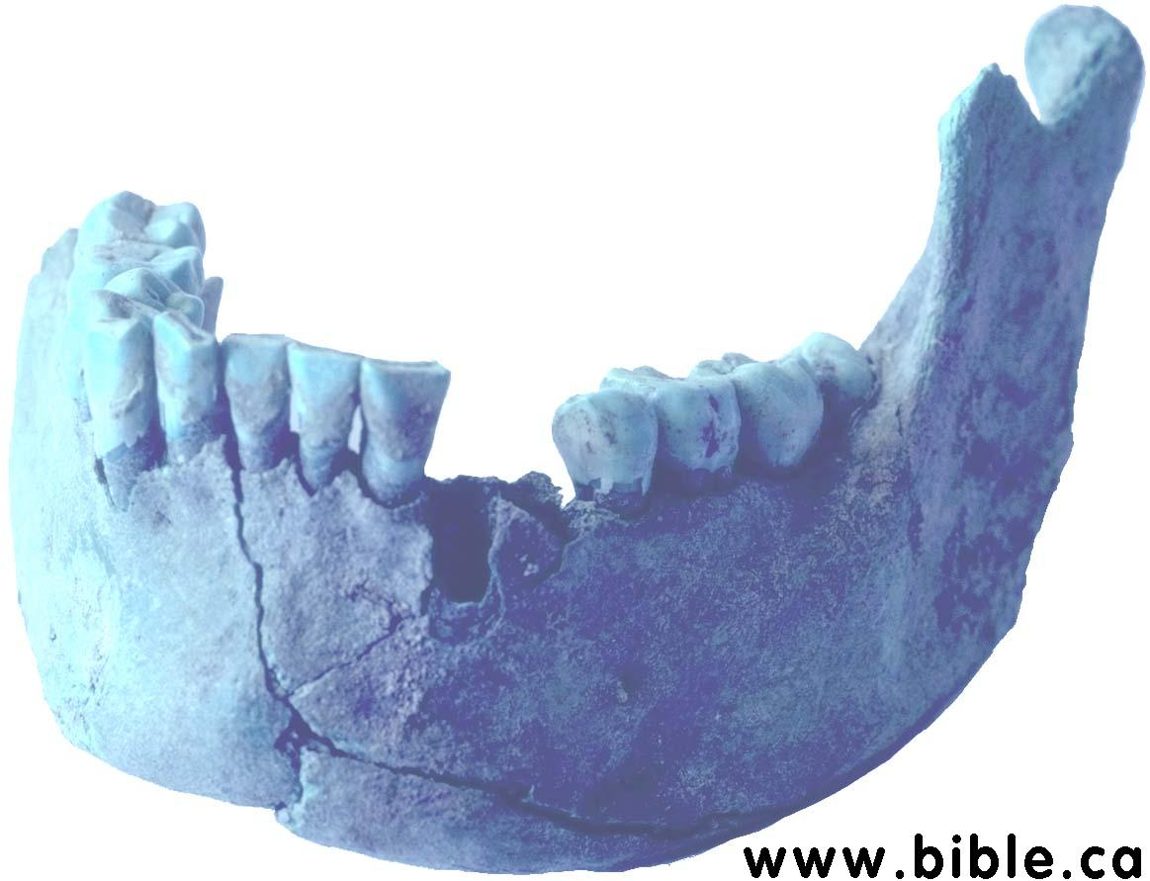
Evidence of the flood
Animals fled to safety as they had time and opportunity
Ten human skeletons found in Lower Cretaceous sandstone – same formation as Dinosaur National Monument!
Notes:
This slide is optional

